Slide 1

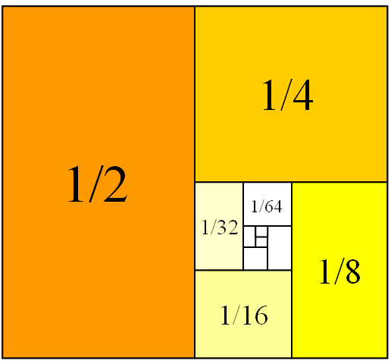
Mathematics for Engineering: Calculus
Chapter 2: LIMITS
Department of Mathematics, FPT University

Slide 2
LIMITS
2.1
A Preview of Calculus
Notes:
The various meanings of “limit” (descriptive, numeric, graphic), both finite and infinite.
The geometric and limit definitions of vertical asymptotes.
The advantage and disadvantage of using a graphing device to compute a limit.

Slide 3
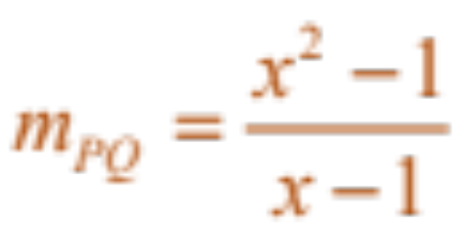
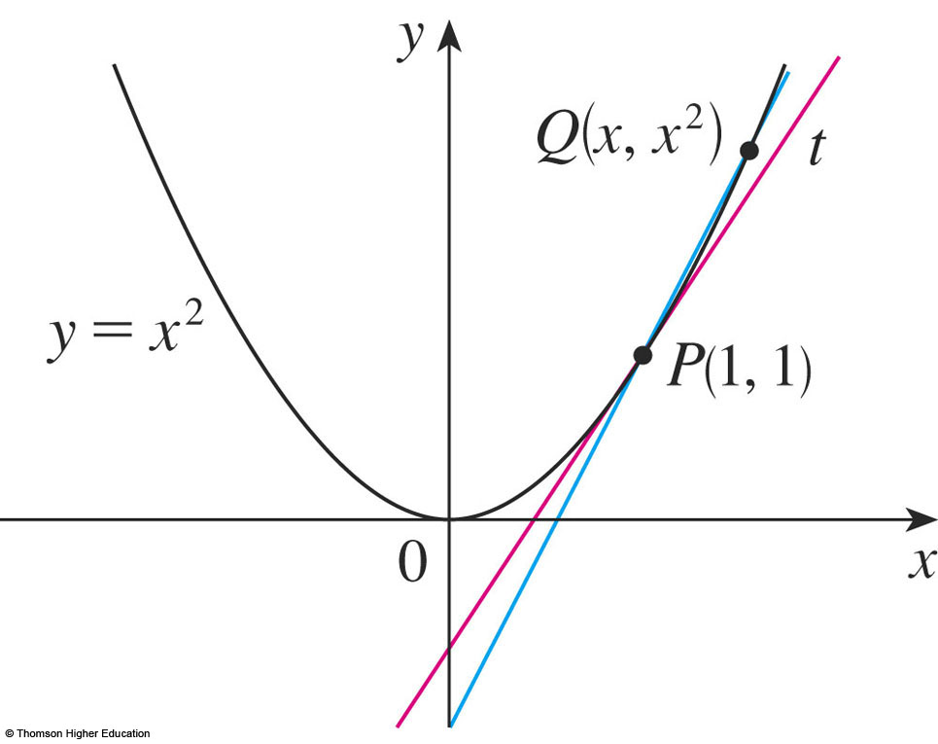
THE TANGENT PROBLEM
Example 1
    We know that the slope of the secant line PQ is
  How to find an equation of the tangent line to the parabola
  y = x² at the point P(1,1)?
Notes:
The slope of tangent line as the limit of slopes of secant lines
m=tanα=tan(PQ,Ox)

Slide 4

THE VELOCITY PROBLEM
Example 2
  Investigate the example of a falling ball.
    Suppose that a ball is dropped
    from the upper observation
    deck of the CN Tower in
    Toronto, 450 m above the
    ground.
    Find the velocity of the ball
    after 5 seconds.
Notes:
Instantaneous velocity

Slide 5
THE VELOCITY PROBLEM
If the distance fallen after t seconds is denoted by s(t) and measured in meters, then Galileo’s law is expressed by the following equation.
s(t) = 4.9t²
Notes:
s(t) = 0,5 g.t²

Slide 6
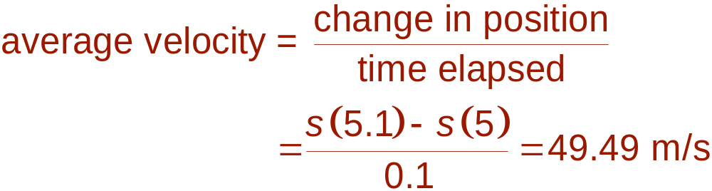
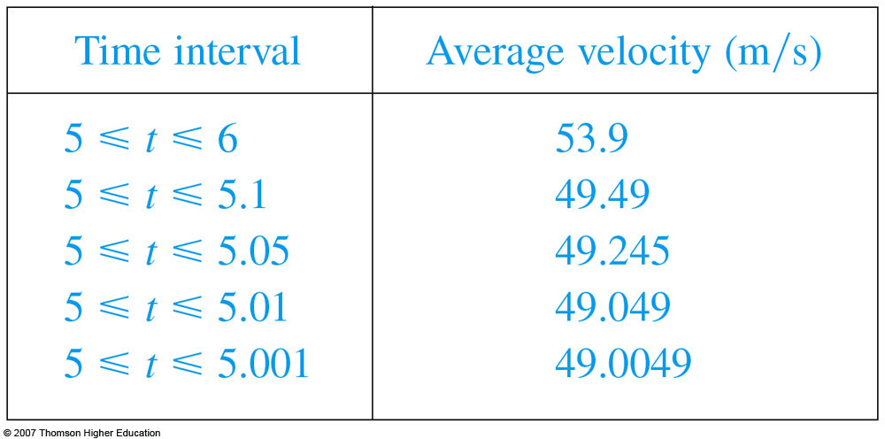
THE VELOCITY PROBLEM
  Thus, the (instantaneous)
  velocity after 5 s is:
  v = 49 m/s

Slide 7
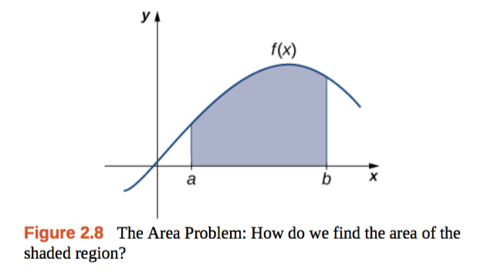
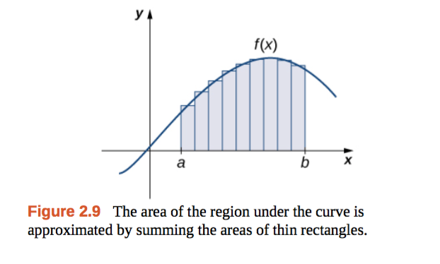
THE AREA PROBLEM
Example 3
We begin by attempting to solve the area problem:
Find the area of the region S that lies under the curve y = f(x) from a to b.
Notes:
The slope of tangent line as the limit of slopes of secant lines
m=tanα=tan(PQ,Ox)

Slide 8
LIMITS
2.2
The Limit of a Function
Notes:
The various meanings of “limit” (descriptive, numeric, graphic), both finite and infinite.
The geometric and limit definitions of vertical asymptotes.
The advantage and disadvantage of using a graphing device to compute a limit.

Slide 9
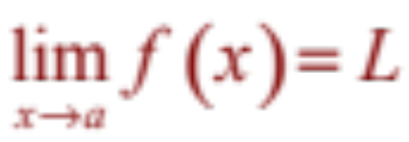
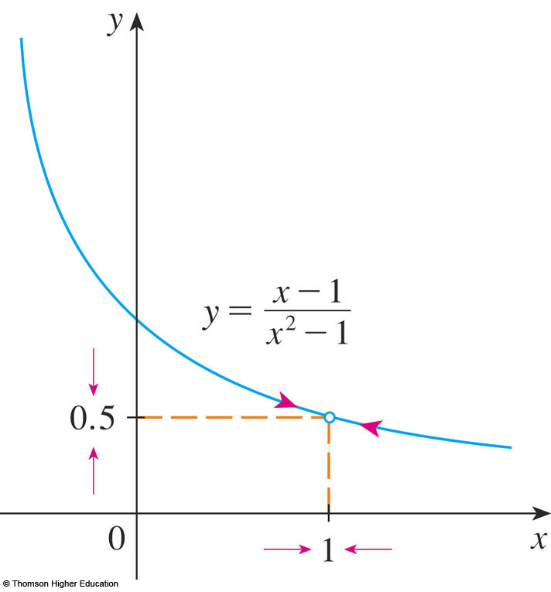
THE LIMIT OF A FUNCTION
In general, we write
if we can make the values
of f(x) arbitrarily close to L
by taking x to be
sufficiently close to a
but not equal to a.
Notes:
f close to L by taking x to be sufficiently close to a but not equal to a

Slide 10
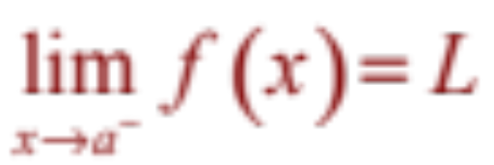
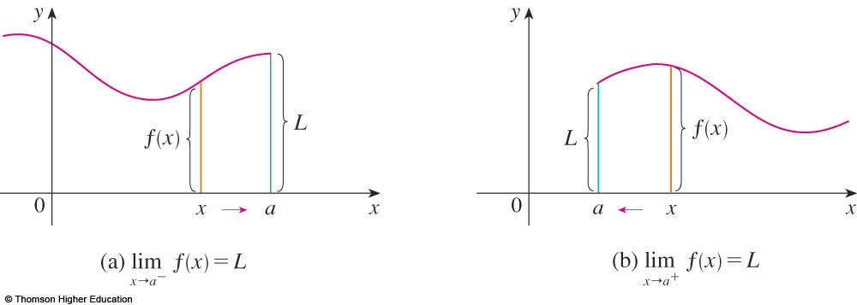
ONE-SIDED LIMITS
We write
if we can make the values of f(x) arbitrarily close to L by taking x to be sufficiently close to a and x less than a.

Slide 11
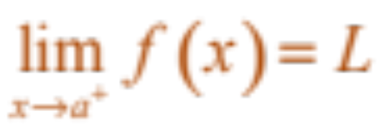
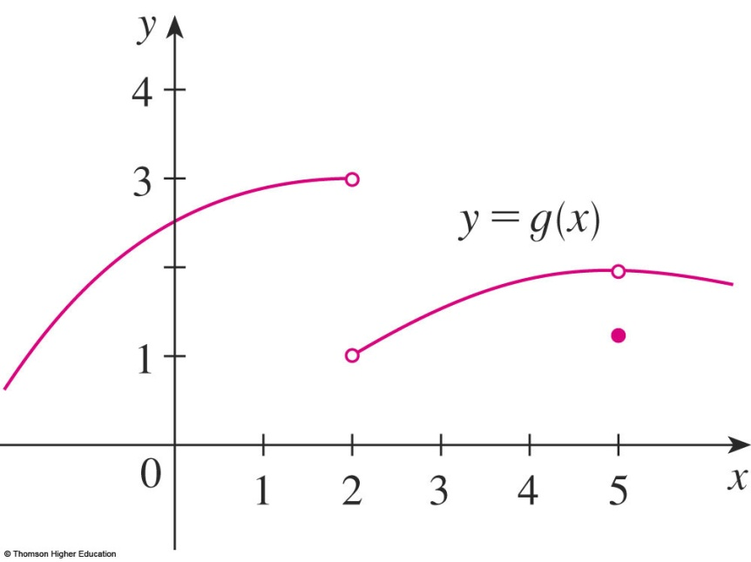
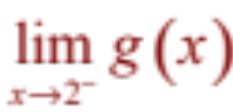
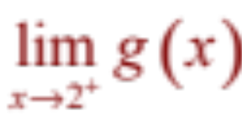
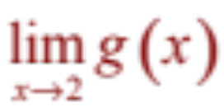
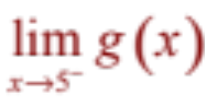
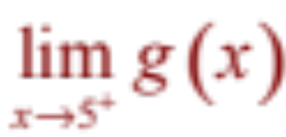
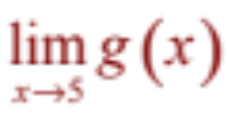
ONE-SIDED LIMITS
Similarly, “the right-hand limit of f(x) as x approaches a is equal to L” and we write

Slide 12
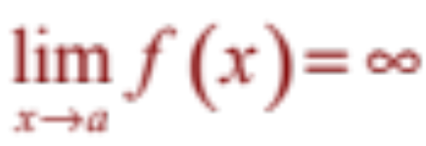
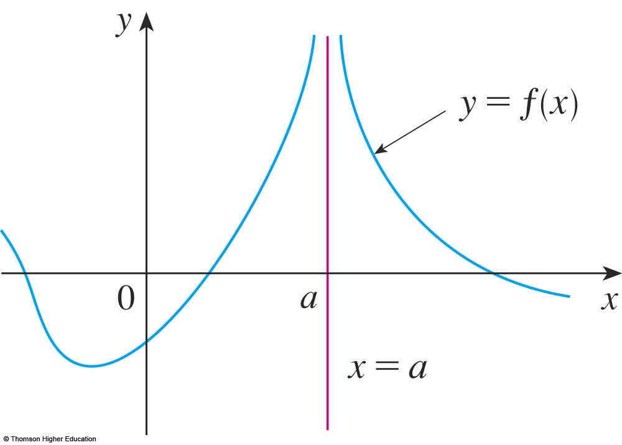
INFINITE LIMITS
Let f be a function defined on both sides of a, except possibly at a itself. Then,
means that the values of f(x)
can be made arbitrarily large
by taking x sufficiently
close to a, but not equal to a.
Notes:
For example

Slide 13
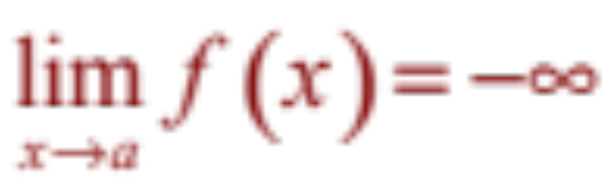
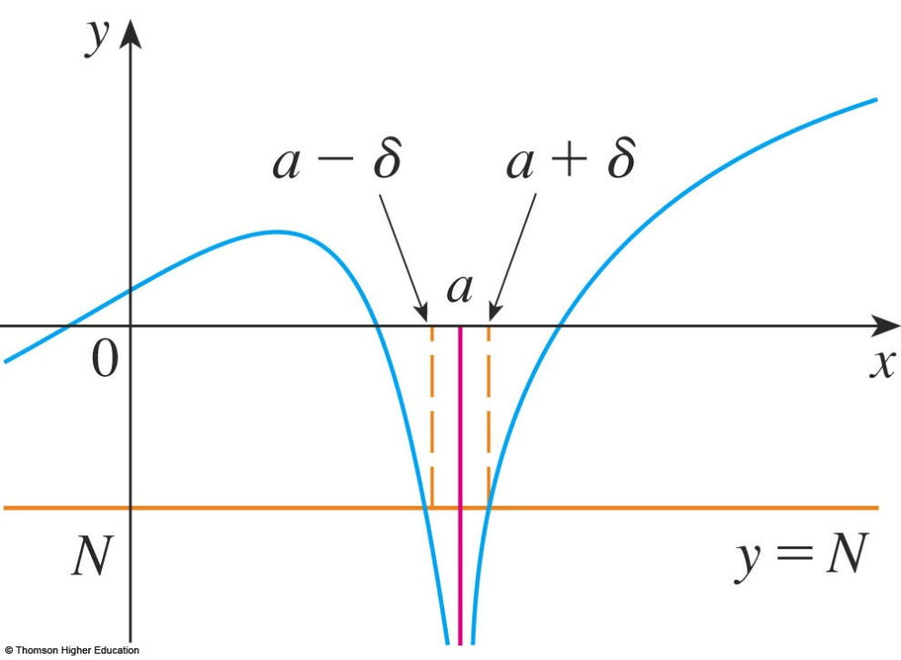
INFINITE LIMITS
Let f be defined on both sides of a, except possibly at a itself. Then,
means that the values of f(x)
can be made arbitrarily
large negative by taking x
sufficiently close to a,
but not equal to a.
Notes:
For example

Slide 14
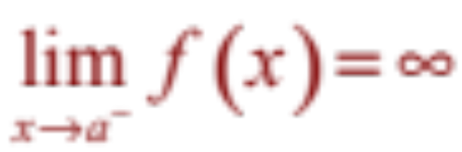
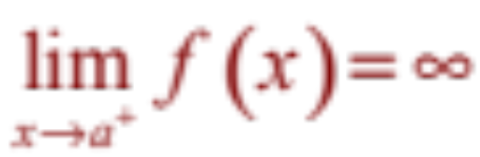
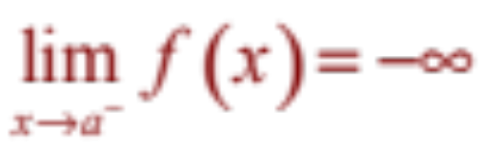
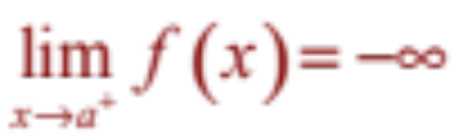
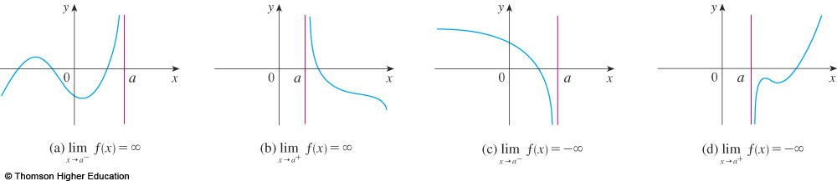
INFINITE LIMITS
Similar definitions can be given for the one-sided limits:

Slide 15
DEFINITIONS
x=a is called the vertical asymptote of f(x) if we have one of the following:
Notes:
For example

Slide 16
LIMITS
2.3
The Limit Laws
In this section, we will:
Use the Limit Laws to calculate limits.
Notes:
The algebra computation of limits: manipulating algebraically, examining left- and right –hand limits, using the limit laws to break monstrous functions into pieces and analyzing the pieces.
The evaluation of limit from graphical representation.
Examples where limits don’t exist.

Slide 17
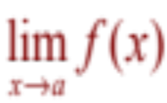
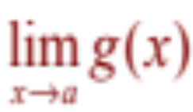
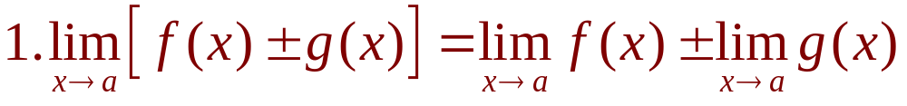
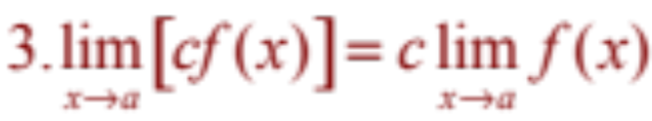
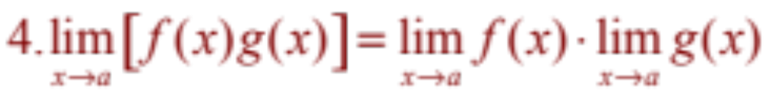
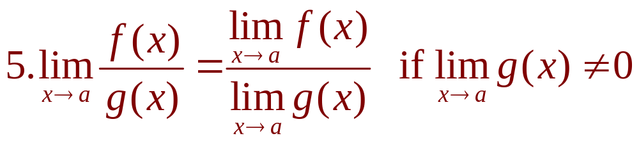
THE LIMIT LAWS
Suppose that c is a constant and the limits
and exist. Then

Slide 18
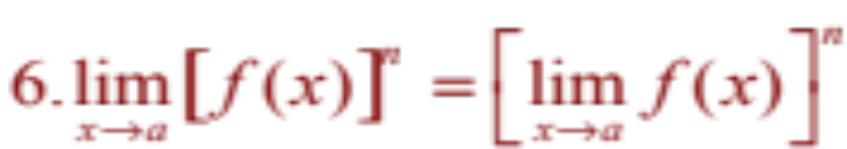
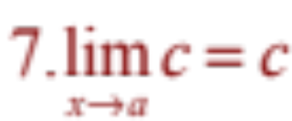
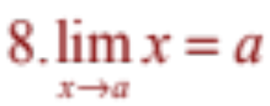
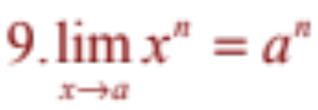
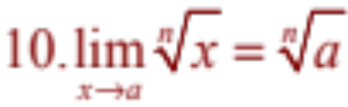
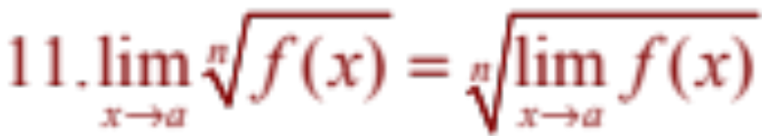
USING THE LIMIT LAWS
where n is a positive integer.

Slide 19
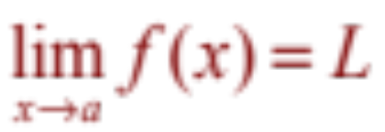
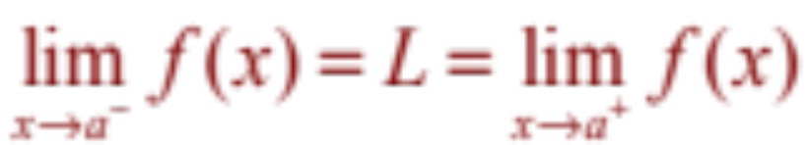
USING THE LIMIT LAWS
if and only if

Slide 20
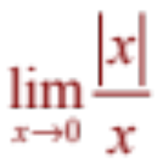
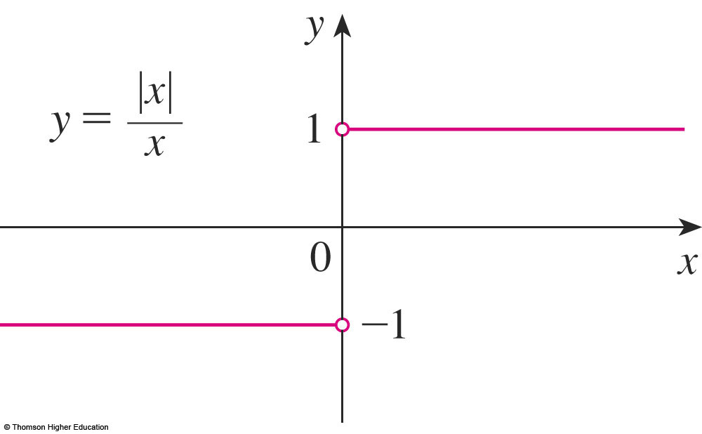
USING THE LIMIT LAWS
Example 4
Prove that does not exist.
Notes:
Use Vertical Test?

Slide 21
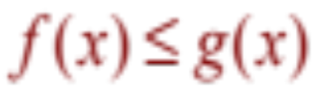
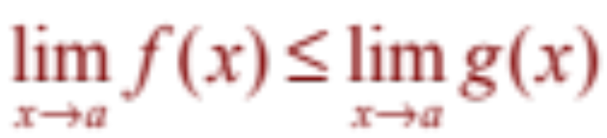
PROPERTIES OF LIMITS
If when x is near a (except possibly at a) and the limits of f and g both exist as x approaches a, then
Notes:
the limits both exist

Slide 22
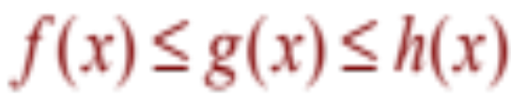
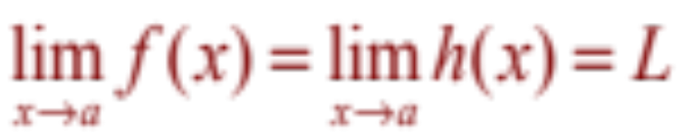
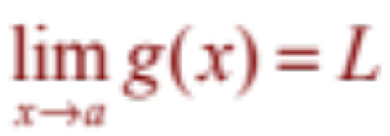
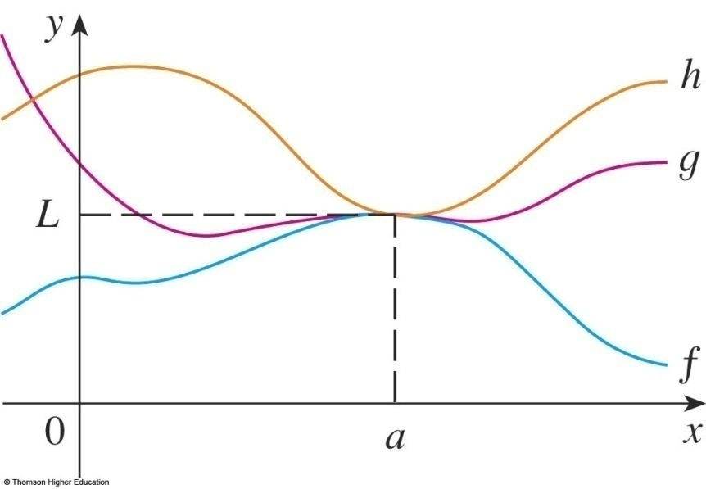
SQUEEZE THEOREM
The Squeeze Theorem (the Sandwich Theorem or the Pinching Theorem) states that, if
when x is near a (except possibly at a) and .Then

Slide 23



USING THE LIMIT LAWS
Example 5
Show that
  Note that we cannot use
  This is because does not exist.

Slide 24




USING THE LIMIT LAWS
Example 5
  However, since ,
  we have:
Taking f(x) = -x², and h(x) = x²
in the Squeeze Theorem,
we obtain:

Slide 25


QUIZ QUESTIONS
If
then
a. True b. False
Notes:
For example …

Slide 26
QUIZ QUESTIONS
If
a. True b. False
Notes:
For example …

Slide 27
LIMITS
2.4
Continuity
In this section, we will:
See that the mathematical definition of continuity
corresponds closely with the meaning of the word
continuity in everyday language.
Notes:
The graphical and mathematical definitions of continuity and the basic principles.
Examples of discontinuity
The Intermediate Value Theorem.

Slide 28




CONTINUITY
A function f is continuous at a number a if:
Notice that :
  f(a) is defined - that is,
  a is in the domain of f
  exists.
Notes:
When function f is NOT continuous at a number a?

Slide 29

CONTINUITY
Definition
If f is defined near a - that is, f is defined on an open interval containing a, except perhaps at a - we say that f is discontinuous at a if f is not continuous at a.
The figure shows the graph of a function f.
At which numbers is f discontinuous?
Why?

Slide 30

CONTINUITY

Slide 31


CONTINUITY
Definition
A function f is continuous from the right
at a number a if
and f is continuous from the left at a if

Slide 32
CONTINUITY
Definition
A function f is continuous on an interval if it is continuous at every number in the interval.
  If f is defined only on one side of an endpoint of the interval, we understand ‘continuous at the endpoint’ to mean ‘continuous from the right’ or ‘continuous from the left.’

Slide 33

CONTINUITY
Theorem
If f and g are continuous at a; and c is a constant, then the following functions are also continuous at a:
1. f + g
2. f - g
3. cf
4. fg
5.

Slide 34
CONTINUITY
Theorem
The following types of functions are continuous at every number in their domains:
  Polynomials
  Rational functions
  Root functions
  Trigonometric functions and their inverses
  Exponential and logarithmic functions.
Notes:
List domain of these functions

Slide 35



CONTINUITY
Theorem
If f is continuous at b and then
In other words,
  If x is close to a, then g(x) is close to b; and, since f
  is continuous at b, if g(x) is close to b, then f(g(x))
  is close to f(b).
Notes:
For example

Slide 36

CONTINUITY
Theorem
If g is continuous at a and f is continuous at g(a), then the composite function
is continuous at a.
  This theorem is often expressed informally by saying
  “a continuous function of a continuous function is
  a continuous function.”
Notes:
For example

Slide 37


INTERMEDIATE VALUE THEOREM
Theorem
Suppose that f is continuous on the closed interval
[a, b] and let N be any number between f(a) and f(b), where
Then, there exists a number c in (a, b) such that f(c) = N.

Slide 38




INTERMEDIATE VALUE THEOREM
Example 6
Show that there is a root of the equation
between 1 and 2.
  Let .
  We are looking for a solution of the given equation—
  that is, a number c between 1 and 2 such that f(c) = 0.
  Therefore, we take a = 1, b = 2, and N = 0 in the theorem.
  We have
  and
Notes:
Exists a root of the equation, can not solve

Slide 39





QUIZ QUESTIONS
1) If f(1)>0 and f(3)<0 then there exists a number c between 1 and 3
such that f(c)=0
True b. False
2) Which is the equation expressing the fact that “ f is continuous at 2”?
a. b.
c. d.
e.

Slide 40



LIMITS AT INFINITY
Let f be a function defined for every x>a. Then
means that

Slide 41

DEFINITION
The line y=L is called the horizontal asymptote of f(x) if we have one of the following:
Notes:
For example

Slide 42



Example
Find the asymptotes of the function
Solution
y=1 is horizontal asymptote

Slide 43

Example
Compute (by looking the graph)
a.
b.
c.
d.
Notes:
Using limit laws

Slide 44


QUIZ QUESTIONS
1) Find
a. 0 b. infinity c. 1 d. Does not exist
2) Find
a. 0 b. infinity c. 1 d. Does not exist

Slide 45


QUIZ QUESTIONS
3) If
Then
a. True b. False
4) A function can have two different horizontal asymptotes
a. True b. False
Notes:
For example…

Slide 46
Thanks

